Slide 1
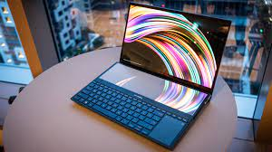

Pro Sportle
Arianna Tibbs, Aleya Jeffery, Nikara Taylor, and Melvin Gates

Slide 2


What Is Pro Sportle?
Wordle + your two favorite Pro-League sports smashed into one game.
Every current player for each team in each division of both sports.
Web-based guessing game
Challenging, creative, fun!

Slide 3
PROCESS DESIGN
I
II
III
IV
Develop Web Scraping Script
Scrape and Store Information
Design Website (G)UI
Compile Project
Using python and several python packages.
Using python, MySQL, and several python packages to format data in database.
Using Django or some other similar python-based web framework.
Implement controls and test.

Slide 4
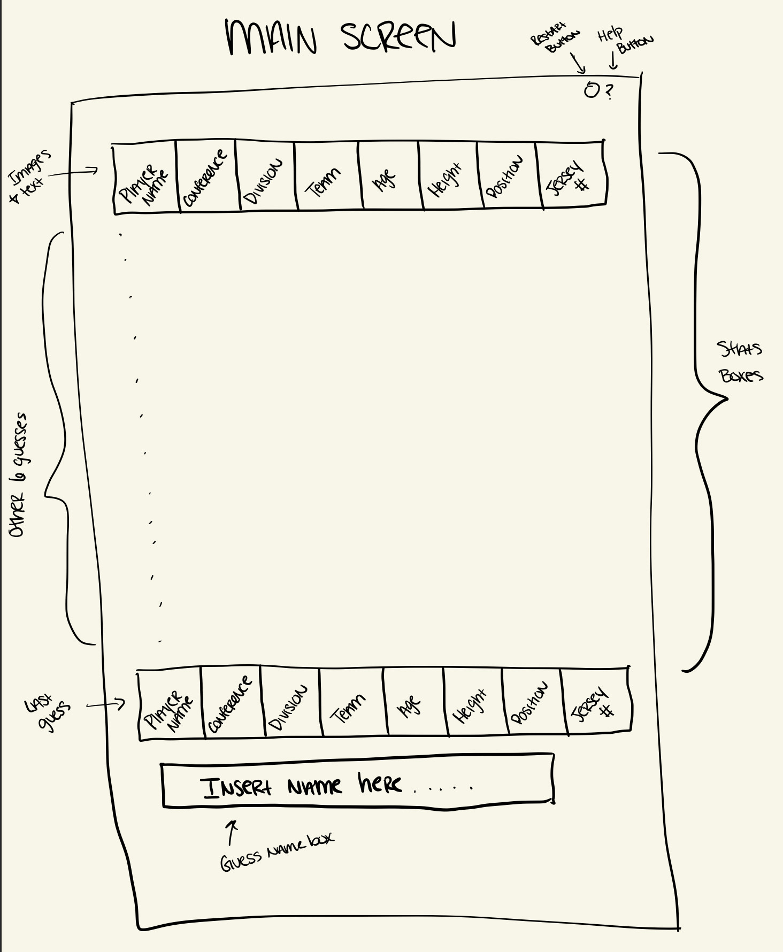
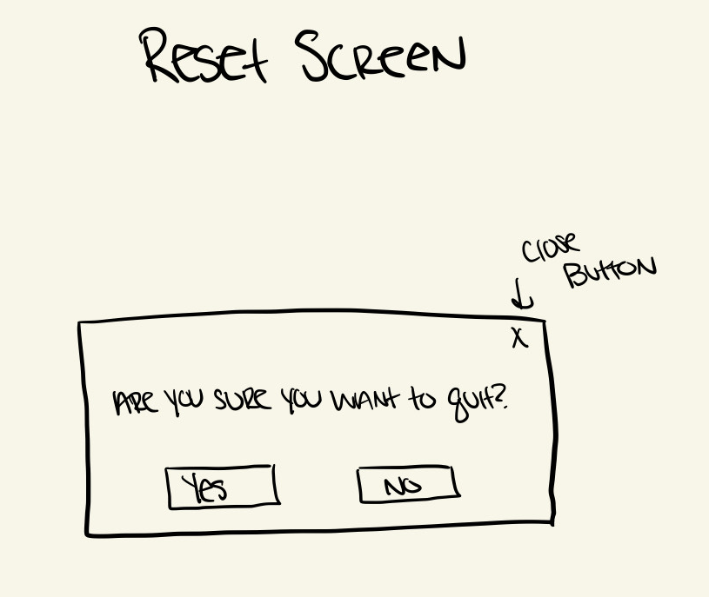
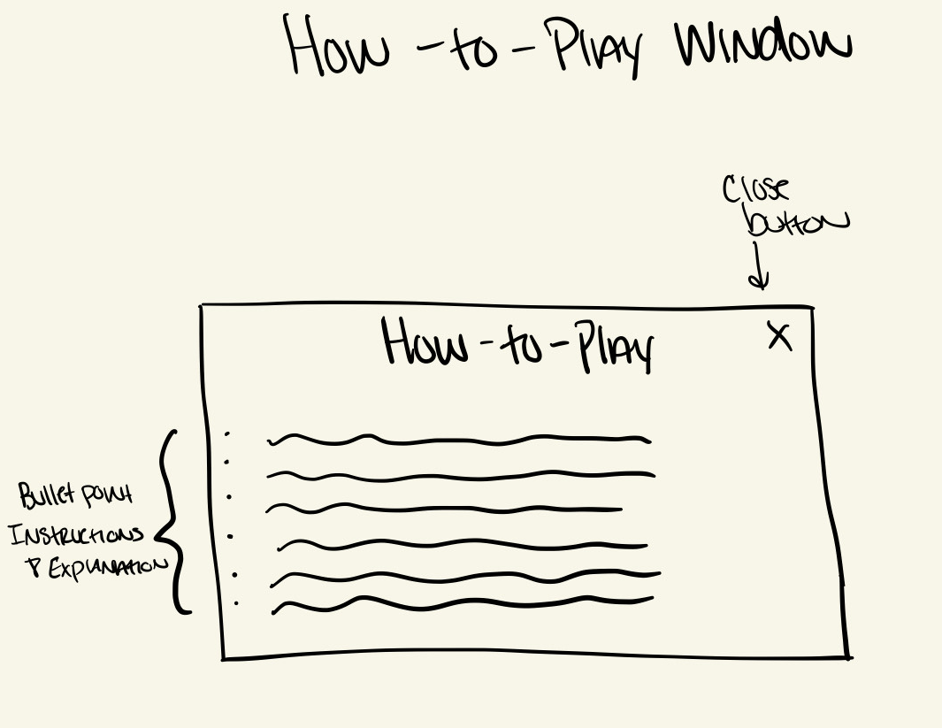
UI DESIGN
Primary windows: Main screen, reset screen, how-to-play window
Utilized Goodnotes to sketch designs
C# in Visual Studio for the prototype
Python, HTML, CSS, for final product

Slide 5
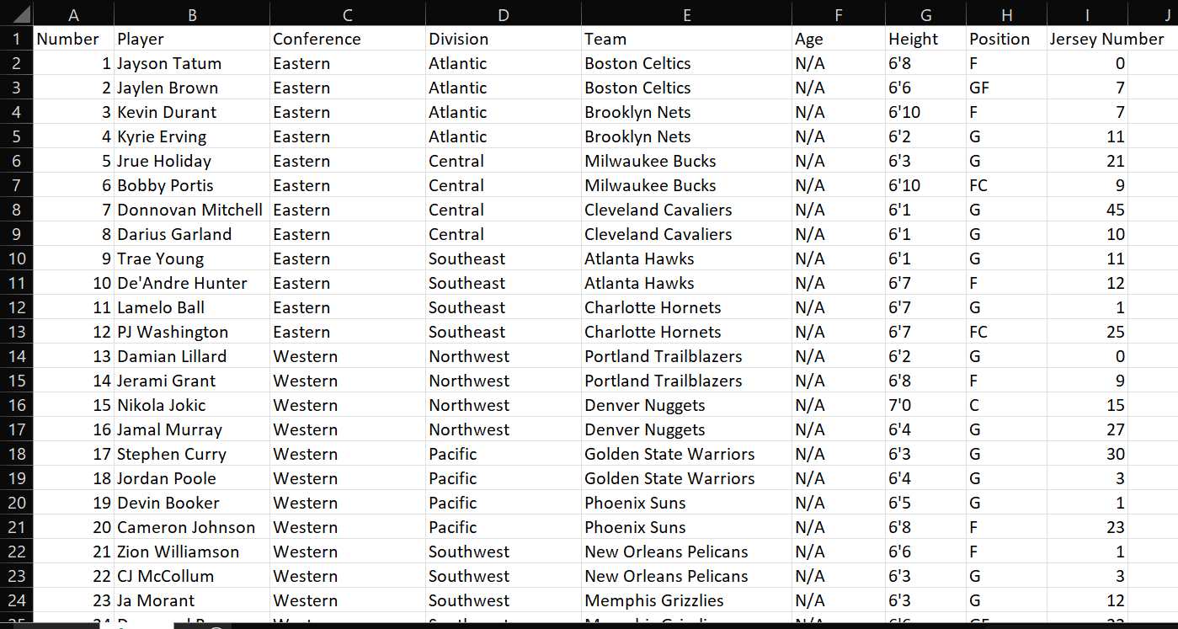
DATABASE DESIGN
Mock database created in Microsoft Excel
MySQL, Python, Pandas, BeautifulSoup for final product

Slide 6
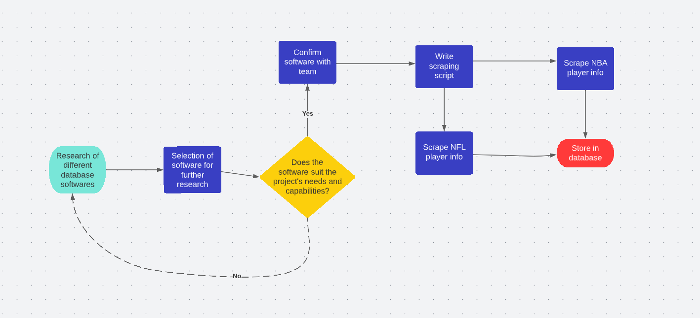
DATABASE WORKFLOW
Requirements Satisfied:
Determine database software.
Create database and reference in python scraping script.
Scrapes and stores all NBA player information.
Scrapes and stores all NFL player information.
References correct player when user enters name.

Slide 7
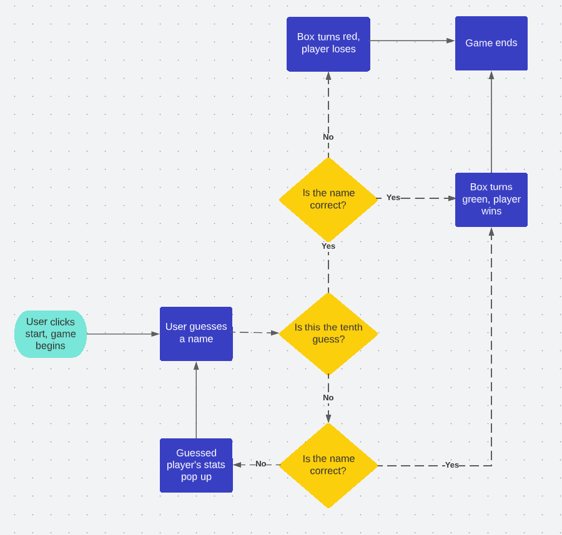
MAIN SCREEN WORKFLOW
Requirements Satisfied:
Allows user to guess names up to ten times.
Checks to see if user has guessed target name.
Displays info of entered user if target name isn’t guessed:
Conference
Number
Player
Conference
Division
Team
Age
Height
Position
Jersey Number

Slide 8
MILESTONES
November 5, 2022 - Prototype completed
February 10, 2023 - Web scraping script complete
Second Week of February - Database created, Information stored
April 1, 2023 - UI built using Django & Tested
Second Week of April - Peer & Professional Reviewing
Third Week of April - Deployment

